Slide 1


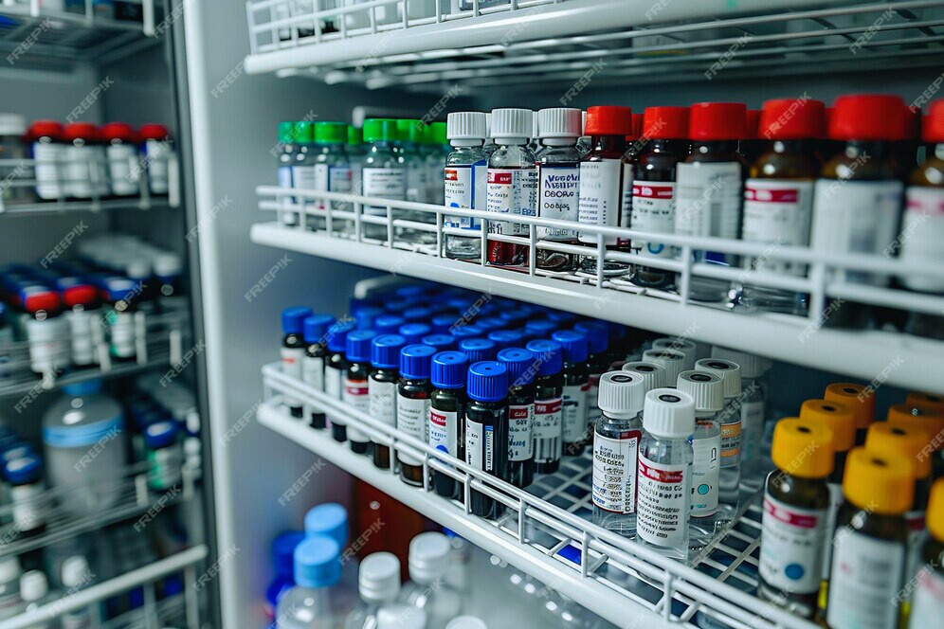
SWE 4304
PHARMA
SYNC
Presented by :
Ahnaf Shahriar Pias ( 220042146 )
Md. Sameur Rahman ( 220042144 )
Irfan Shafee ( 220042164 )
===================================

Slide 2




MOTIVATION BEHIND
THE PROJECT
We aim to automate pharmacy tasks like inventory tracking and sales. It reduces errors and improves efficiency in managing medicines.

Slide 3
PROJECT OVERVIEW
--> Enables efficient management of medicine inventories with detailed information
--> Supports sorting and filtering while viewing medicines.
--> reporting features that alert about expiring medicines and low stock levels
--> Ensures that the pharmacy remains well-stocked

Slide 4


KEY
FEATURES
Stock Manipulation
View Medicine
1
Name
1
Search
2
Generic Name
2
Sort
3
Supplier
3
Filter
4
Price
5
Quantity
6
Expiry Date

Slide 5

KEY
FEATURES
Sell Medicine
Notification
1
Add items to cart
1
Notification for expiry
2
Show Subtotal
2
Notification for low stock
3
Print Recipt
4
Automated Stock Reduction
Future Scope
*
Selling trends.

Slide 6
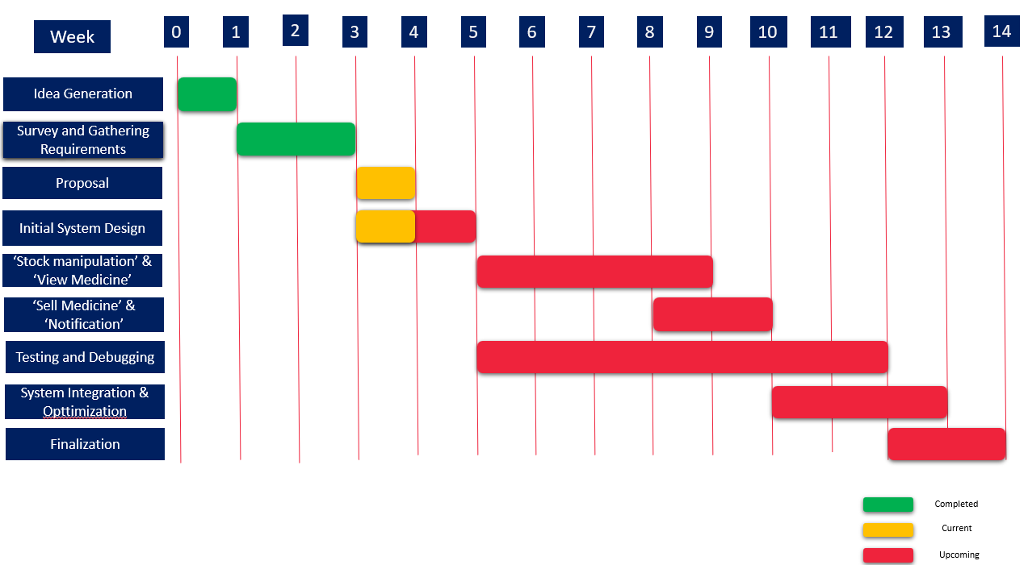
Project Timeline

Slide 7





Tools & Technologies

Slide 8
==* THANK YOU *==

